Slide 1
APL DnA: Knewton Analytics Platform (KAP)
2022-05-12
Presenter: Alex Heitzmann

Slide 2
Agenda
Meet the team
What are analytics? Product perspective / Engineering perspective
Integrating with KAP
KAP evolution, past, present, and future
If time, some design discussion

Slide 3



Who are we?
Wilpattu: The Knewton Enterprise Platform (KEP) engineering team
https://confluence.wiley.com/x/2B_HBw
Vicuña: The KAP engineering team
https://confluence.wiley.com/x/mGT1Bg
Camery: The analytics data science team
https://confluence.wiley.com/x/2F31Bg
^ they're fancier than they like to admit
Product Managers: Tiara Kelly, Andrew Jones, Anita Nikanen

Slide 4
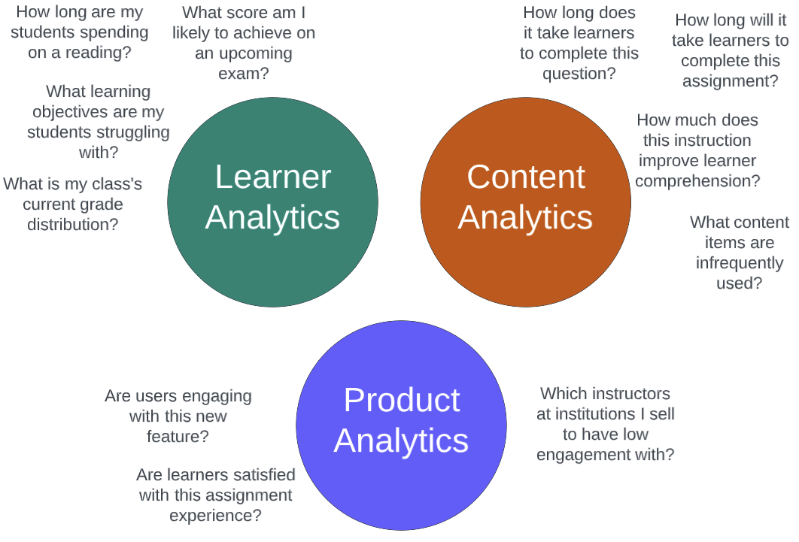
What are "Analytics" Product Perspective
Notes:
Quantitative or qualitative insights about X
The categories in this slide are the different TARGETs of analytics – that is, about what or whom are they providing insight.
Note that Product Analytics are part of analytics convergence, but they are not currently in-scope for KAP.
More complex business insights can be gained by joining across these categories. For example, we could correlate feature engagement with outcomes, controlling for other factors.
Also joinable with sales data

Slide 5


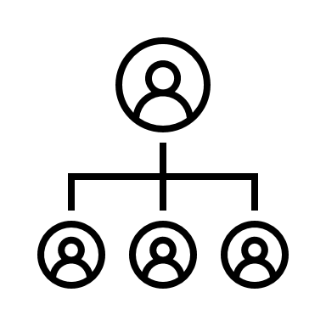

Who are Analytics For?
Instructors
Learners
Wiley Colleagues
Institutional Admins
APL Products
PowerBI
APIs
Data Warehouse
Knewton Analytics Platform
Notes:
This categories in this slide are the different audiences of analytics – that is, who may be consuming the insights they provide Talk here about benefits of convergence.

Slide 6
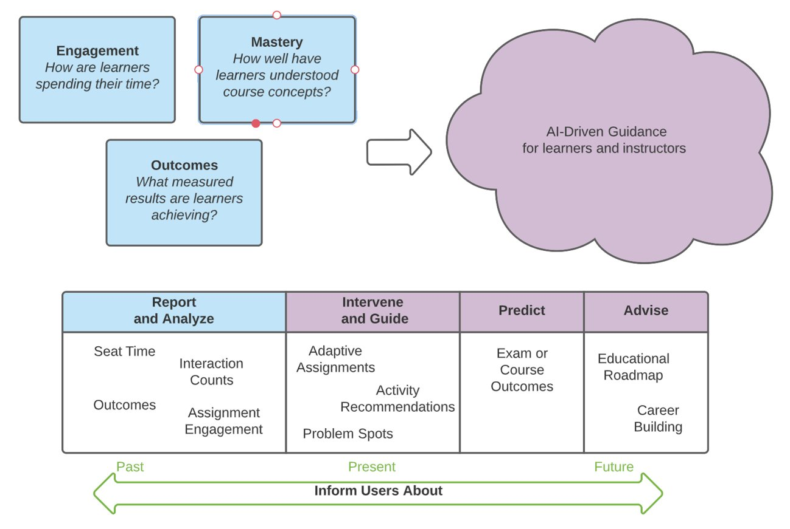
Learner Analytics

Slide 7
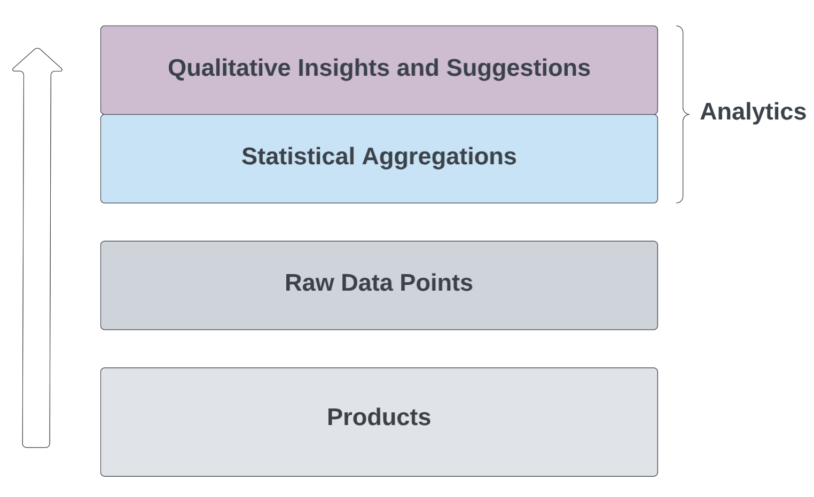
What are "Analytics": Eng Perspective
Our take:
Statistical aggregations over filtered collections of raw data points recorded by products
-- AND --
Qualitative AI-driven insights and suggestions based on those aggregations
Notes:
What about a grade. This could be a statistical aggregation of the scores of the items in an assessment, with some configuration accounted for. Grading policies, however, have to do with

Slide 8
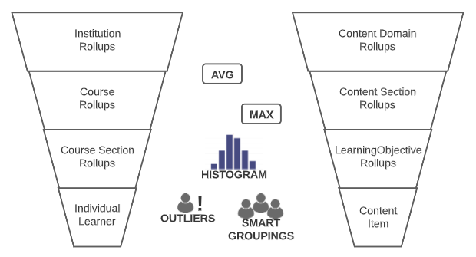
Rollups - Higher-order aggregations
"Rollups" are a category of analytics that we define as simple statistical aggregations over other analytics.
Filter on groups of learners
Filter on groups of content

Slide 9
Example: Seat Time
Name | Seat Time
Description | An estimate of the time that a learner spent actively working on something
Raw Data | Item Interactions | duration
Aggregation Function | Sum, with max duration exclusions
Filters | Learner IDs / Cohort ID Assignment IDs Content Item IDs Context Taxon IDs Learning Objective IDs

Slide 10
Example: Concept Proficiency
Name | Concept Proficiency
Description | A measure of a learner’s understanding of a concept/learning objective
Raw Data | Item Interactions | duration, score, knowledge graph module ID
Requrired Enrichments | Knowledge Graph
Learned Parameters | Module difficulty
Aggregation Function | MaRNA Proficiency Model
Required Filters | Learner ID Concept ID
Optional Filters | Assignment ID
<-- We'll return to these in a bit

Slide 11
Example: Item Recommendation
Name | Item Recommendation
Description | A recommendation of a content item that should next be presented to a learner to most effectively progress them towards completion of an adaptive goal.
Raw Data | Item Interactions | duration, score, knowledge graph module ID
Requrired Enrichments | Knowledge Graph Adaptive Goal
Parameters | Learner ID Adaptive Goal ID
Analytics Utilized | Concept Proficiency Goal Progress Item Novelty ...
Notes:
A "qualitative" insight

Slide 12
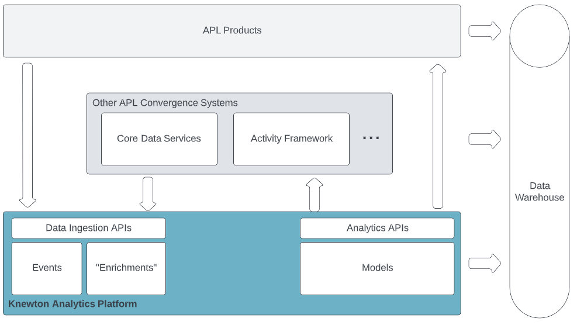
KAP Integration

Slide 13
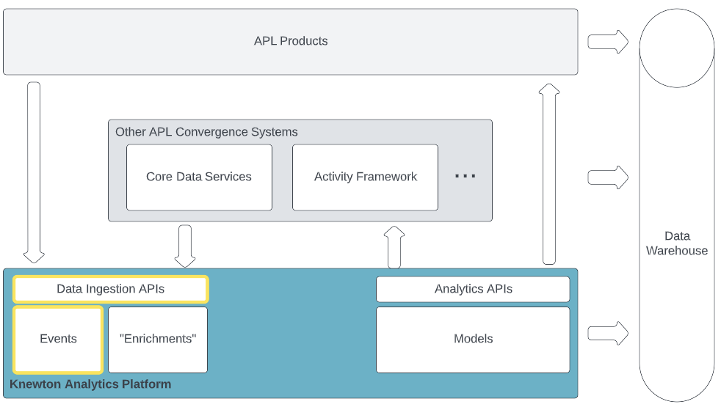
KAP Integration – Events
Legacy Knewton Events
Content Item interactions
Caliper Events
Content Item interactions
Assignment engagement
Assignment outcomes
Any other Caliper-compliant events
Notes:
Event data is all ingested to the warehouse for BI

Slide 14
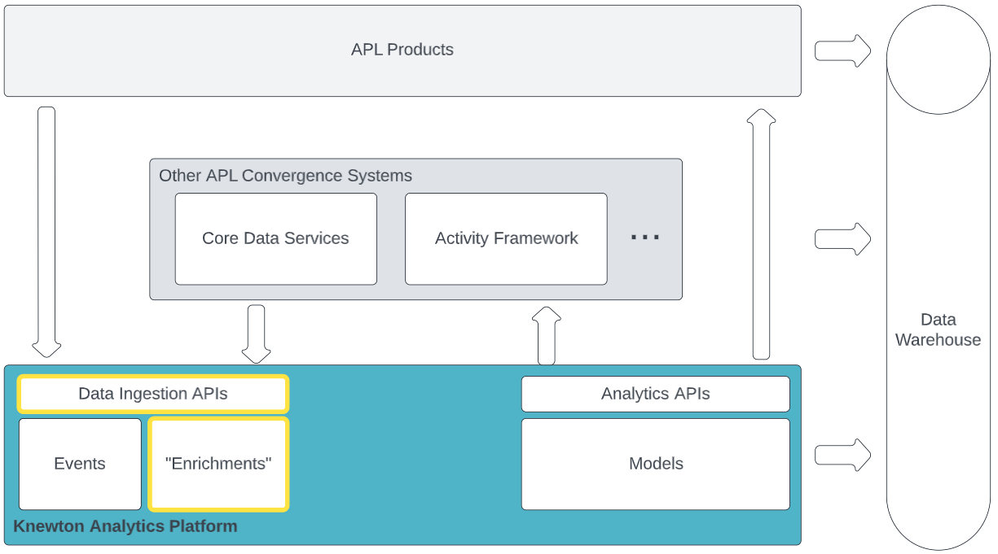
KAP Integration – Enrichments
Optional data structures that add meaning to event data
Knowledge Graphs
Enable mastery-based analytics
Define relationships between content and concepts
Goal Definitions
Enable adaptive assignments
Define target LOs, desired pedagogy, completion criteria

Slide 15
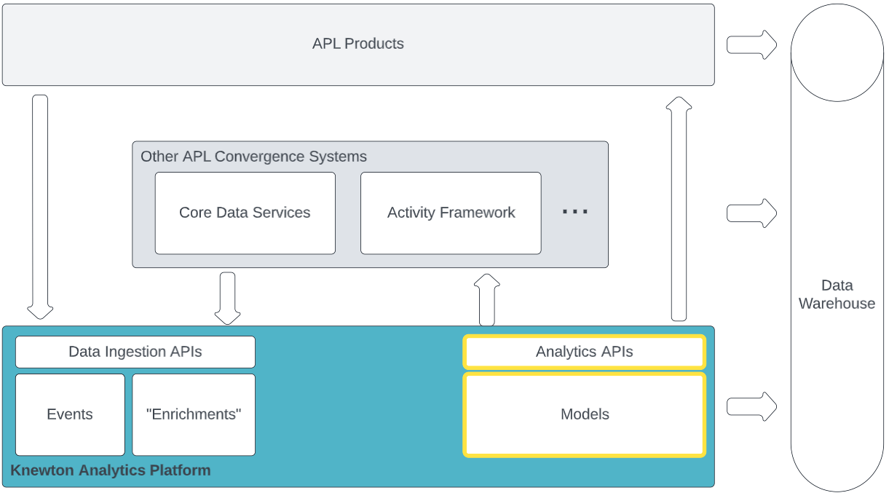
KAP Integration – Analytics APIs
Models cooperate in processing ingested data and learned parameters to produce analytics, which are exposed through APIs.
Models may be run in different execution environments, depending on the needs.

Slide 16
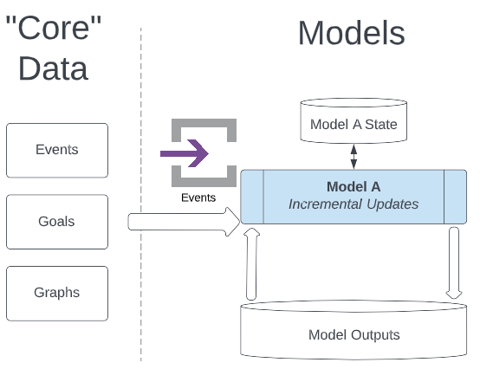
Model Execution – Incremental Updates
Models can incrementally update their internal state and their externally visible outputs, triggered by events.
Model inputs can include
Data in the event payload
Data from KAP's core services
Data output by other models

Slide 17
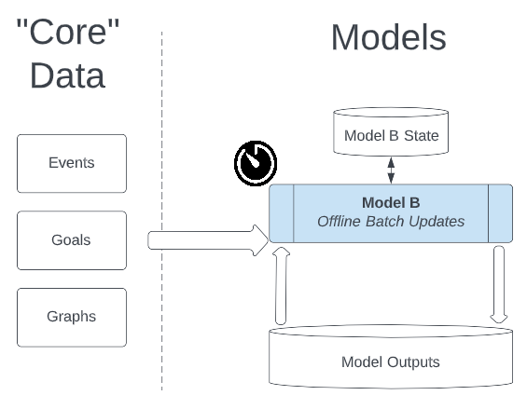
Model Execution – Batch Processing
Batch jobs can be run periodically to execute models that need to process large amounts of input data.
Model inputs can include
Data from KAP's core services
Data output by other models
Data typically pulled from data warehouse sources rather than live services.

Slide 18
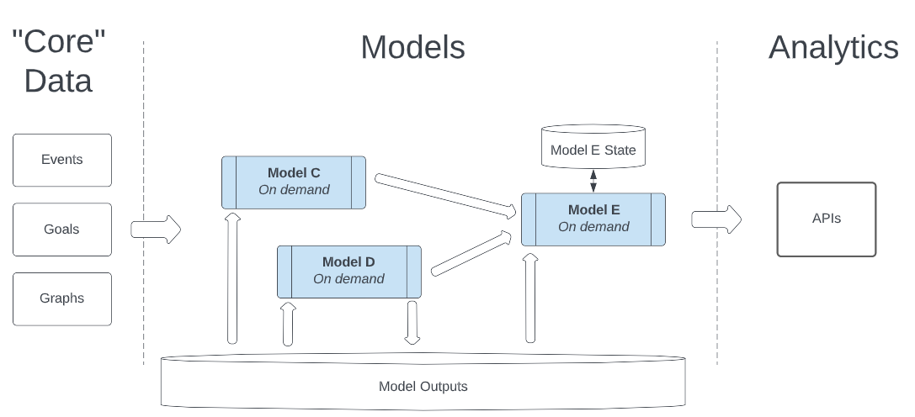
Model Execution – On-Demand
Models can run on-demand when their output is requested through the analytics API layer, or by another model.
Model inputs can include
Data from KAP's core services
Data output by other models

Slide 19
Model-Runner Framework
Separates the mathematical model function (typically authored by the data science team) from the mechanisms for
Triggering execution of the model
Gathering model inputs
Retrieval and persistence of internal model state across runs
The execution environment (microservice, Spark, cron, etc)

Slide 20
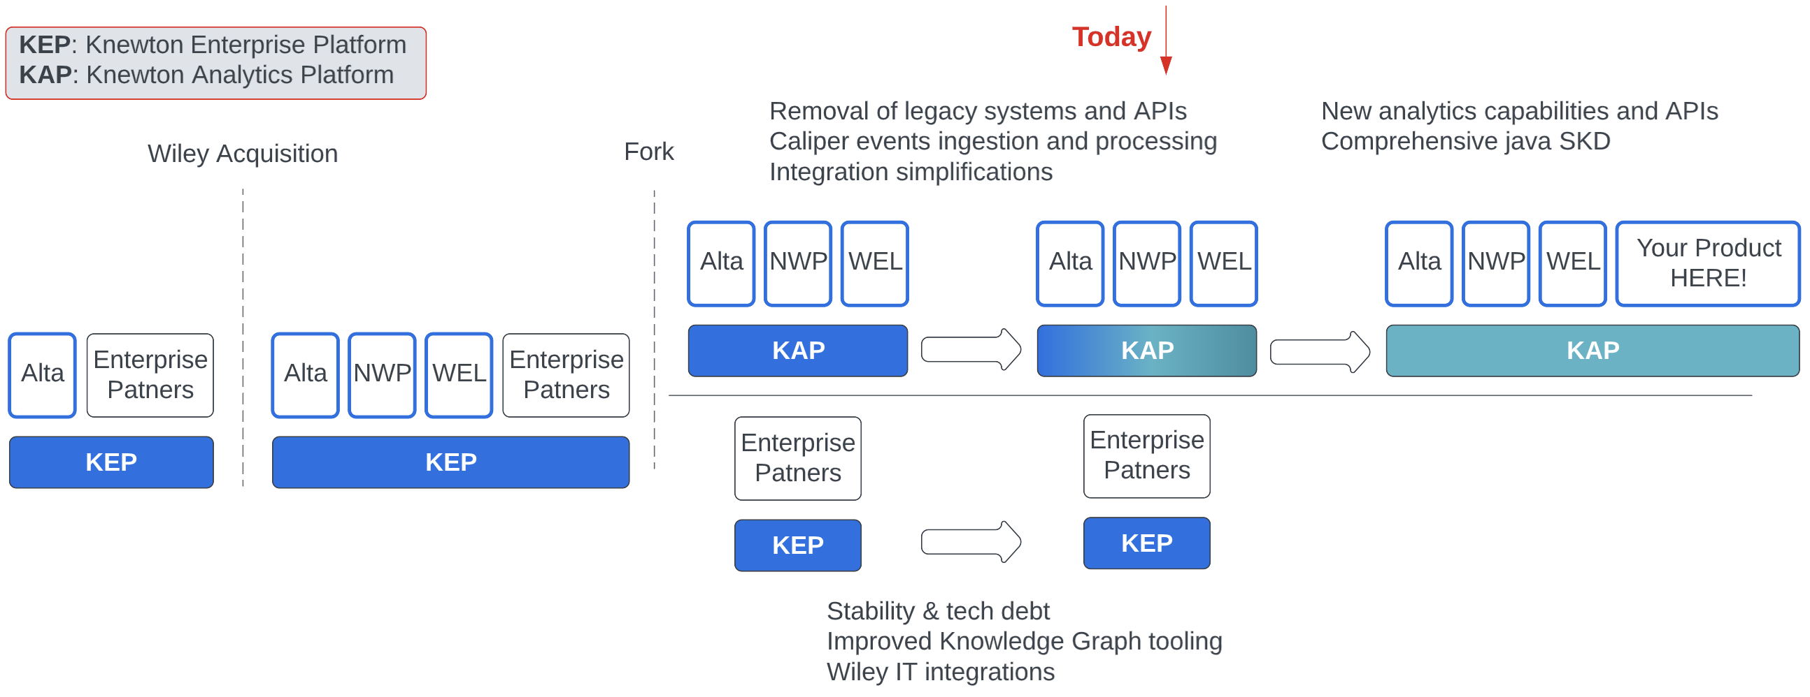
KAP Evolution, Past, Present, Future

Slide 21
Tech Stack Modernization
Old | New
Jetty, Jersey, Guice | Spring Boot, Spring IOC
Knewton custom config management tools & libraries | Spring Boot configuration properties
Knewton Central Config | Kube ConfigMaps
Thrift + Knewton custom reliable RPC libraries | GRPC
Knewton custom tracing library | Brave
Knewton custom metrics library + Graphite | Micrometer + Prometheus
Self-managed Cassandra | Managed DB services (PostgeSQL RDS, DynamoDB)
Self-managed Kafka & Zookeeper | Managed streaming services (MSK, Kinesis)
Eureka service discovery | Kube DNS (or a Service Mesh when moving to convergence VPC)
Knewton Custom OAuth implementation | KeyCloak

Slide 22
What’s Next? V2 APIs
New Caliper Event ingestion API. Completed: EVENTS section of https://kap-api-docs.pages.wiley.tools/
New Analytics APIs for accessing existing analytics without registrations and learning instances. In Draft: ANALYTICS section of https://kap-api-docs.pages.wiley.tools/
New Goal Management APIs for using adaptive goals without learning instances Early-Stage Planning

Slide 23
What’s Next? FY23 and beyond
Enable products to more easily build instructor dashboards
Batch analytics: Power paged tables of learner analytics for instructor dashboards by providing an analytic for many learners with a single request.
Rollups: Power summary visualizations for instructor dashboards by providing simple statistical aggregations over a collection of analytics results.
Notes:
Design discussion could happen here: Precomputation of intermediate results, embracing eventual consistency, & the need for history versioning and model output versioning.

Slide 24
What’s Next? FY23 and beyond
Power new types of adaptive experiences with Quick Review adaptive behavior.
Provide engagement and outcomes analytics
Work with data engineering org to power data-driven decision making throughout APL
Internal: Enhancing ML-driven self-improving models
Connect academic and professional learning analytics
Notes:
Also: Agency improvements
Success coaching – 2nd half of the FY?

Slide 25
Resources
KAP API Documentation: https://kap-api-docs.pages.wiley.tools/ (Requires github account in the All-Wiley GitHub team)
Reach out to our team at vicuna@wiley.onmicrosoft.com or in the Knewton Integrations MS Teams team
A more business/product-focused deck on analytics convergence: APL Convergence_Adaptive Learning and Analytics.pptx

